Slide 1
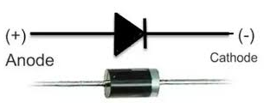
Diodes
A diode is a two-terminal electronic component that conducts electricity primarily in one direction. It has high resistance on one end and low resistance on the other end.
Diodes are essentially one-way current gates.
Diodes are used to protect circuits by limiting the voltage and to also transform AC into DC

Slide 2
Diodes
AC provides a means for us to distribute electrical power, but most devices actually want DC
bulbs, toasters, heaters, fans don’t care: plug straight in
sophisticated devices care because they have diodes and transistors that require a certain polarity.
rather than oscillating polarity derived from AC
this is why battery orientation matters in most electronics
Use diodes to “rectify” AC signal
Simplest rectifier uses one diode:
input voltage
voltage seen by load

Slide 3
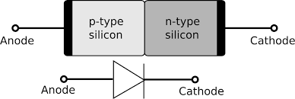
Diodes
The P-N junction diode includes two layers of semiconductors. One layer of the semiconductor material is fixed with P-type material and the other layer with N-type material. The combination of these both P and N-type layers form a junction known as the P-N junction.
A p-n junction diode is a basic semiconductor device that controls the flow of electric current in a circuit. It has a positive (p) side and a negative (n) side.

Slide 4
Diode Construction
Diodes can be made of either of the two semiconductor materials, silicon and germanium. When the anode voltage is more positive than the cathode voltage, the diode is said to be forward-biased, and it conducts readily with a relatively low-voltage drop. Likewise, when the cathode voltage is more positive than the anode, the diode is said to be reverse-biased.

Slide 5
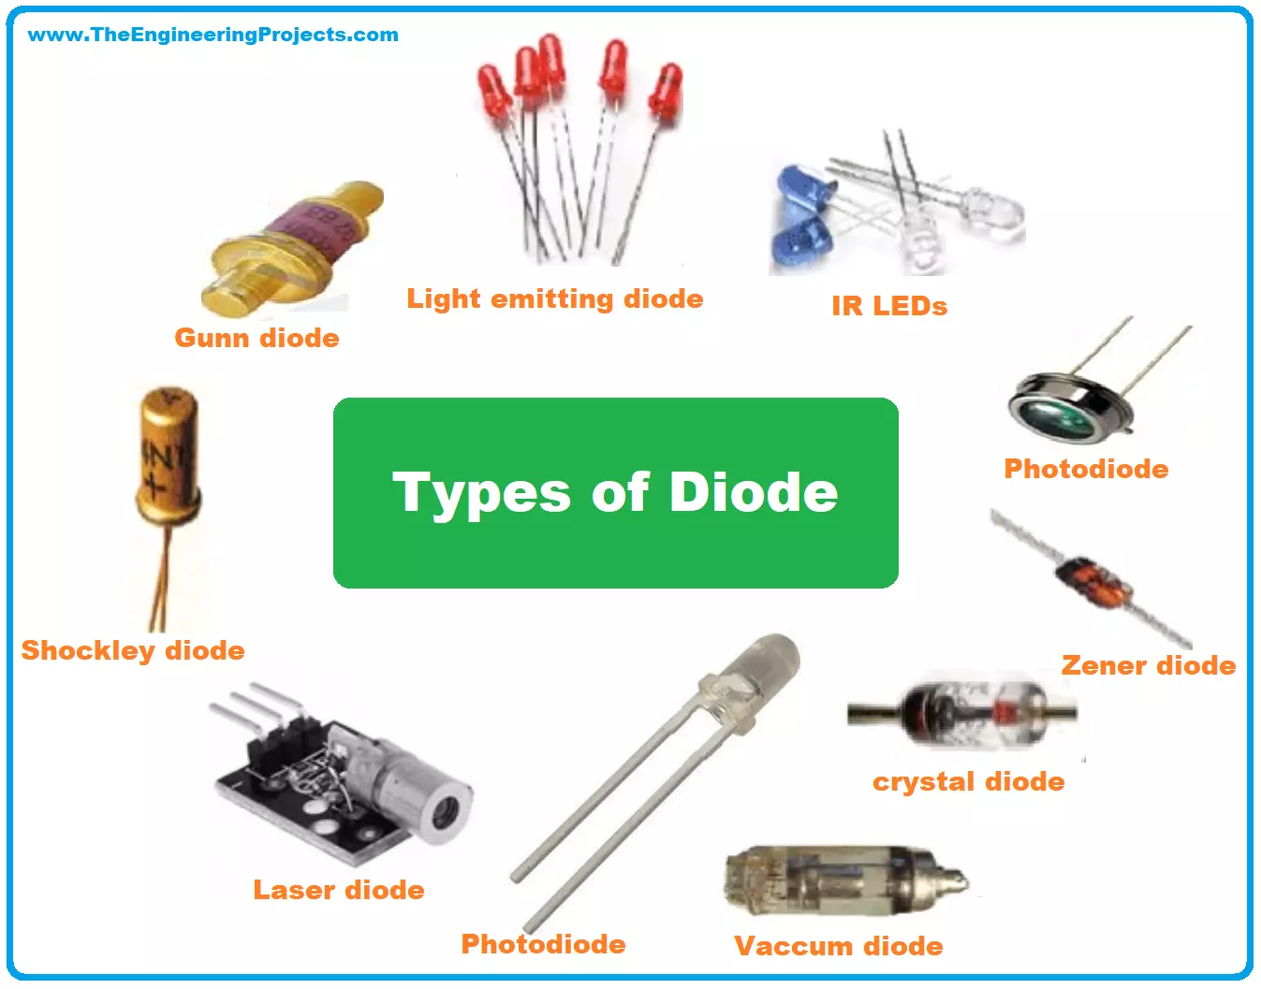
Types of Diodes
Light Emitting Diode
Laser diode
Zener diode
Schottky diode
Photodiode
PN junction diode

Slide 6
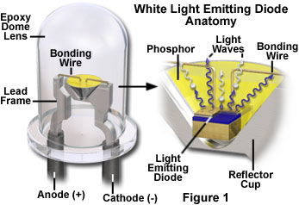
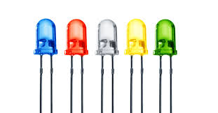
Light Emitting Diode (LED)
When an electric current between the electrodes passes through this diode, light is produced. In other words, light is generated when a sufficient amount of forwarding current passes through it. In many diodes, this light generated is not visible as there are frequency levels that do not allow visibility.

Slide 7
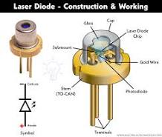
Laser Diode
A laser diode (or diode laser) is a semiconductor device that undergoes stimulating emission to emit coherent light.
t is highly used in CD drives, DVDs and laser devices. These are costly when compared to LEDs and are cheaper when compared to other laser generators. Limited life is the only drawback of these diodes.

Slide 8
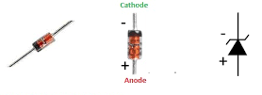
Zener Diode
It is the most useful type of diode as it can provide a stable reference voltage. These are operated in reverse bias and break down on the arrival of a certain voltage. If current passing through the resistor is limited, a stable voltage is generated. Zener diodes are widely used in power supplies to provide a reference voltage.

Slide 9
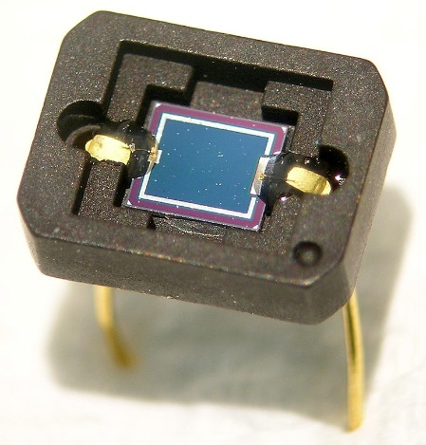
Photodiode
A photodiode is a PN-junction diode that consumes light energy to produce an electric current. They are also called a photo-detector, a light detector, and a photo-sensor.
A photo-diode can identify even a small amount of current flow resulting from the light.
These are very helpful in the detection of the light. This is a reverse bias diode and used in solar cells and photometers.

Slide 10
P-N Junction Diode
The P-N junction diode is also known as rectifier diodes. These diodes are used for the rectification process and are made up of semiconductor material. The P-N junction diode includes two layers of semiconductors.
One layer of the semiconductor material is fixed with P-type material and the other layer with N-type material. The combination of these both P and N-type layers form a junction known as the P-N junction. Hence, the name P-N junction diode.
P-N junction diode allows the current to flow in the forward direction and blocks the flow of current in the reverse direction.

Slide 11
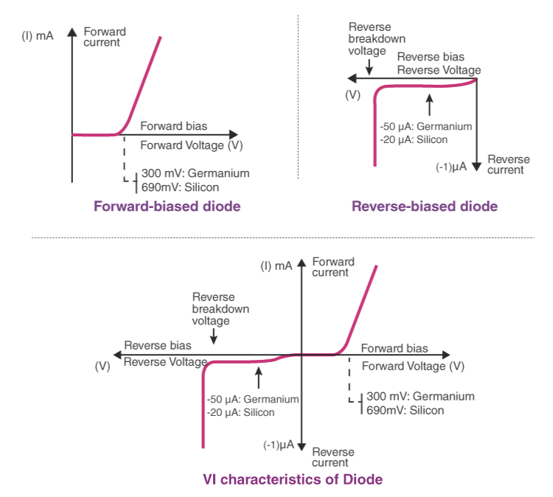
Characteristics of Diode
The following are the characteristics of the diode:
Forward-biased diode
Reverse-biased diode
Zero biased diode

Slide 12
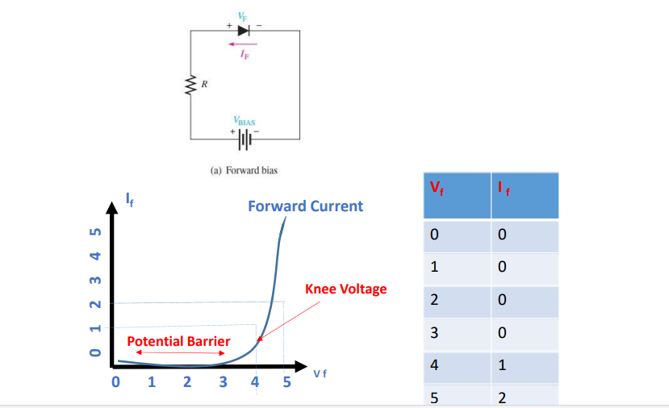
Characteristics of Diode

Slide 13
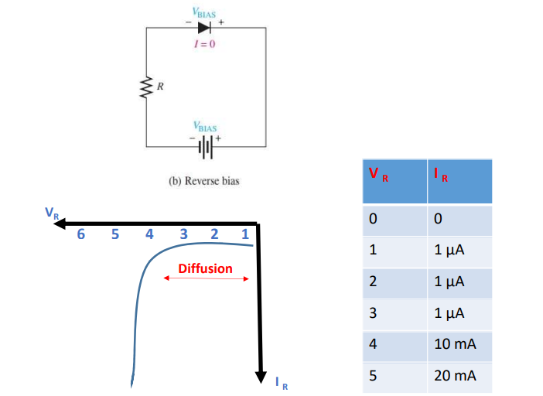
Characteristics of Diode

Slide 14
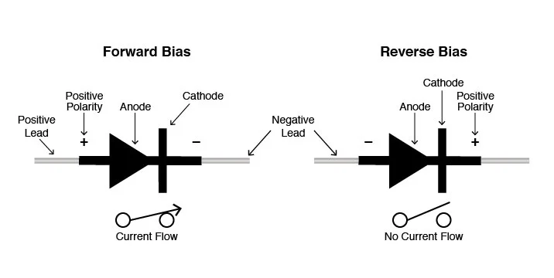
Characteristics of Diode

Slide 15
Forward-biased Diode
There is a small drop of voltage across the diode when the diode is forward-biased and the current is conducting. For silicon diodes, the forward voltage is 690mV and for germanium, 300mV is the forward voltage. The potential energy across the p-type material is positive and across the n-type material, the potential energy is negative.

Slide 16
Reverse-biased Diode
A diode is said to be reverse-biased when the battery’s voltage is dropped completely. For silicon diodes, the reverse current is -20μA and for germanium, -50μA is the reverse current. The potential energy across the p-type material is negative and across the n-type material, the potential energy is positive.

Slide 17
Zero-biased Diode
When the diode is zero-biased, the voltage potential across the diode is zero.

Slide 18
Diode Applications
Following are the applications and uses of the diode:
Diodes as a rectifier
Diodes in logical gates
Diodes in reverse current protection

Slide 19
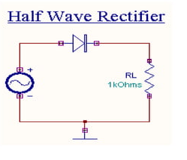
Rectifier
A rectifier is an device which convert alternative Current AC into direct current DC , this process is called rectification.
Half wave rectification : it is the simplest type of rectification , which is made with just one diode.
When the voltage of the alternating current is positive the diode become forward-biased and current flow through it.
When the voltage is negative , the diode is reverse-baised and the current stop.

